Slide 1

Scoring Criteria

Slide 2
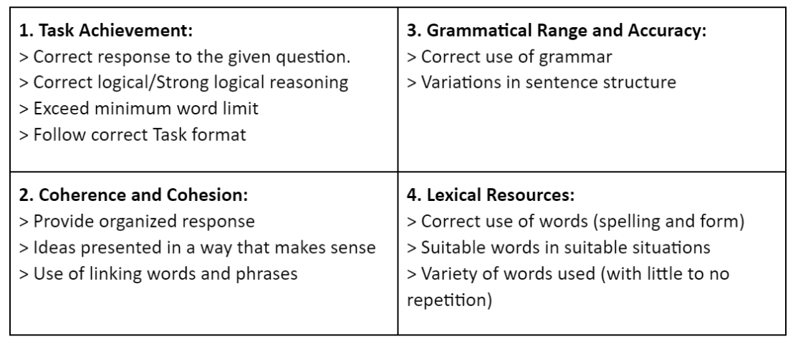
Scoring Criteria

Slide 3
Each Task Marking Criteria and Overall Score for Task 1/2
Task Achievement | 9
Cohesion & Coherence | 9
Grammar | 9
Lexical Resource | 9
Total | 36
Each Task = 36/4 = 9

Slide 4
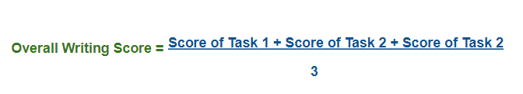

For example, if you get 7 in Task-1 and 6.5 in Task-2, your overall writing score will be calculated in the following way given below.
Writing Score =
Writing Score = 20/3 = 6.66 = 6.5 (because the score is rounded up or down to the nearest half score)

